Slide 1
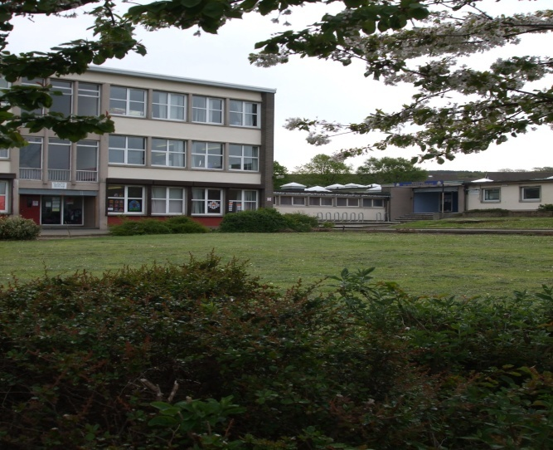
Welcome to Mayfield Primary School

Slide 2
Getting it Right for Your Child
Learning Assistants
Headteacher
Parents & Families
Class Teacher
Support for Learning Teacher
Depute Head Teachers
Admin Staff
SLC Staff
Principal Teachers
Home School Practitioner

Slide 3
Primary 1 Classes
This session we will have two Primary 1
classes.
Primary 1B will be taught by Mrs Beechman
Primary 1M will be taught by Miss Miller
Fern class will be taught by Mrs Robson

Slide 4
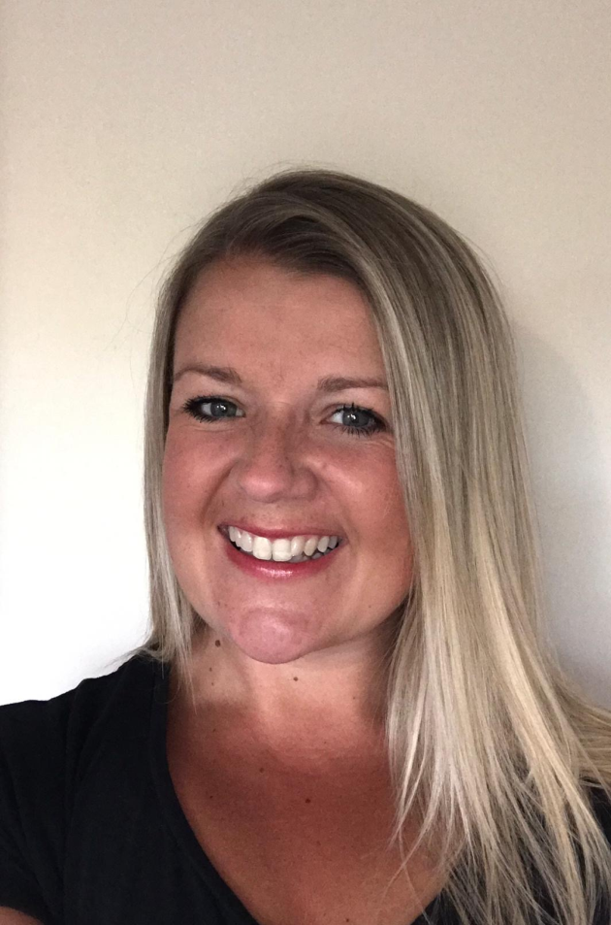
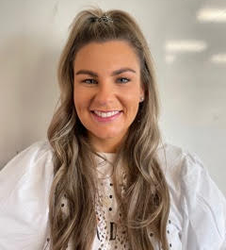
Meet our Teachers
This is Mrs Beechman, she will be teaching P1B
This is Miss Miller, she will be teaching P1M

Slide 5
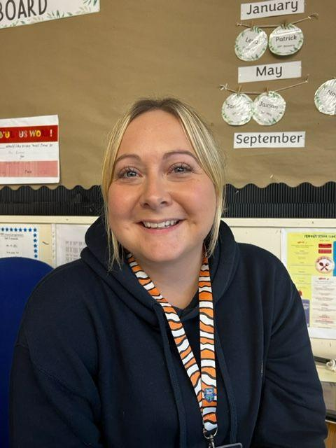
Meet our Teachers
This is Mrs Robson , she teaches our Fern class

Slide 6
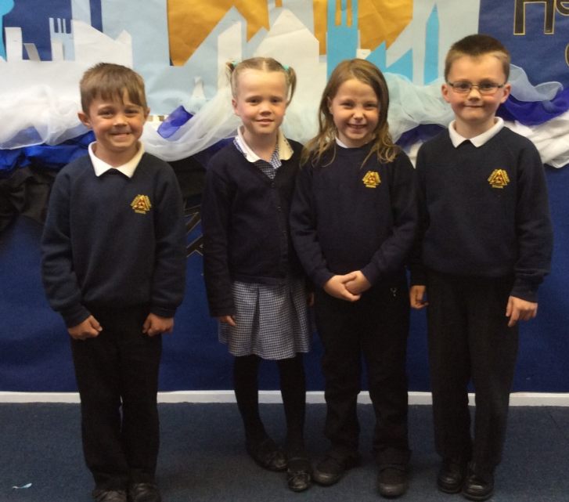
School Uniform
Navy blue sweatshirts, jumper or cardigan
White or navy polo shirts or
School shirt or blouse
Navy or black school trousers, skirt or pinafore
Navy and white checked summer dress
Information for ordering has already been emailed by school admin.
ALL LABELLED PLEASE!

Slide 7
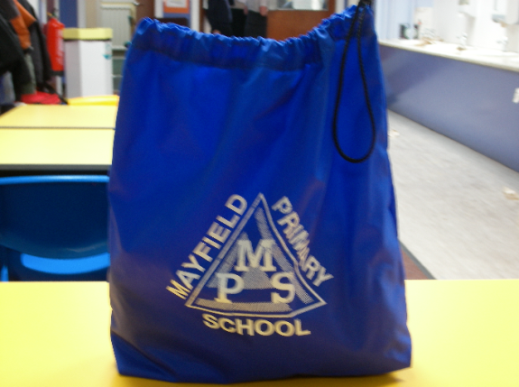
Gym Kit
Plain t-shirt
Shorts
Gym shoes
All should be name labelled, packed in a gym bag and stored in the classroom.

Slide 8
Bits and Bobs
School bags should be big enough to hold an A4 book or folder.
Each child in Primary 1 will be given a navy book bag to keep their homework jotter, any reading book and letters or correspondence home. Please check this daily and encourage your child to tell the teacher if a letter is to be returned to the school.
The school will provide pencils, colouring pencils, rubbers and sharpeners for pupils in P1.

Slide 9
School Dinners
All pupils in P1-P5 are entitled to a free school lunch daily, including a packed lunch on a Friday.
There are no hot school dinners on a Friday.
Alternatively children can bring their own packed lunch to school. We encourage healthy packed lunches. Please clearly label your child’s packed lunch bag/box.
Parent Pay activation details – emailed from school office.

Slide 10
Snacks and Milk
Milk
We have a milk time each day. Milk information has been emailed to you with links to free milk, free school meal entitlement and clothing grant.
Please also provide water in a bottle that can be kept in the classroom throughout the day.

Slide 11
Snack
We encourage healthy snacks for playtime.
One snack is sufficient for morning break.
We are a nut free zone. Please do not send nuts or foods containing nuts to school.

Slide 12
Medical Information
It is really important that our school is kept up to date with any medical conditions.
If your child has:
Medical condition
Takes regular medication
An allergy
Food intolerance
Can you please let a member of staff know today.

Slide 13
Communication
We do our best to inform you of work planned for your child as well as whole school issues through:
Email
Text message
Newsletters
Twitter
Seesaw

Slide 14
Communication with the School
Office Staff
Class Teacher
Principal Teacher
Depute Head Teacher
Head Teacher

Slide 15
Attendance and Lateness
Midlothian Council has an expectation for all pupils in primary schools to have attendance of 96% or higher
Our school monitors attendance very closely to ensure pupils wherever possible meet this expectation
Our school also monitors pupil lateness on a weekly basis
Our school has a set of procedures to monitor attendance and lateness, and parents will be contacted with regards to this
Holidays during term time are not supported by Midlothian Council and are marked as unauthorised absences
Please make sure you phone the school office if your child is going to be off school ill, so that we can mark this on our registers

Slide 16
Support for Families
Home School Practitioner
Breakfast club – Monday to Thursday 8:30-8:50am
Family breakfast club on a Friday 8:30-8:50am
School Clothing Store
And much more to be shared in August 23

Slide 17
First Few Days in P1
First day of P1 is Wednesday 16 August 2023
Day | Times | Collection and Drop Off | Any other info
Wednesday 16th August | 9.00am – 12.00noon | At the lower school entrance | Small snack Packed lunch will be sent home
Thursday 17th August | 8.50am – 12.00noon | At the lower school entrance | Small snack Packed lunch will be sent home
Friday 18th August | 8.50am – 12.05pm | At the lower school entrance | Small snack Packed lunch will be sent home

Slide 18
Primary 1 Times
Day | Times | Collection and Drop Off
Monday to Thursday | 8.50am – 3.20pm | At the lower school entrance
Friday | 8.50am – 12.05pm | At the lower school entrance

Slide 19
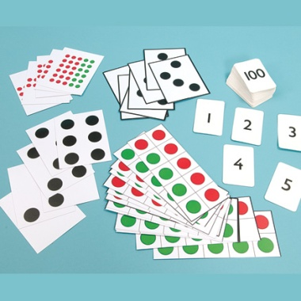
What we learn in P1
Literacy
Health & Wellbeing
Numeracy & Mathematics
French
Social Studies
Technologies & Science
Expressive Arts
Religious & Moral Education

Slide 20
We look forward to meeting all our children and families and welcoming you into our school.
We are one campus and work together with Mayfield NS and St. Luke’s RC PS to ensure we meet the needs of our families.

