Slide 1
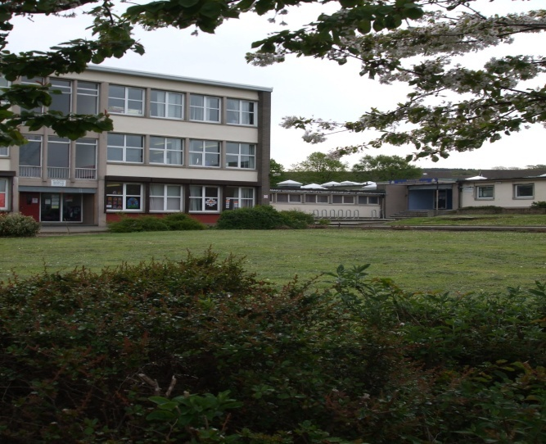
Welcome to Mayfield Primary School

Slide 2
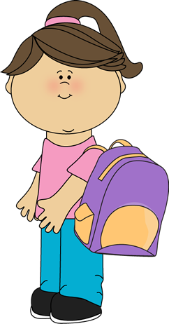
Getting it Right for Your Child
Learning Assistants
Headteacher
Parents & Families
Class Teacher
Support for Learning Teacher
Depute Head Teacher
SLC Staff
Admin Staff
Home School Practitioner

Slide 3
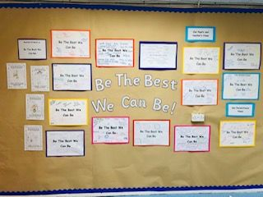
Our School Motto
Be The Best We Can Be
We use this motto in all we do in class, assemblies and outdoors. Our children and families know what this means to them and we ALWAYS ensure we are THE BEST WE CAN BE!

Slide 4
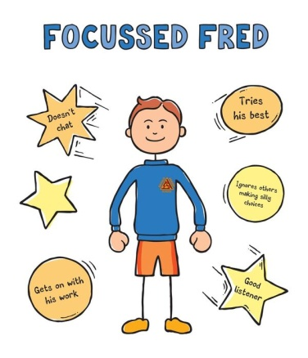
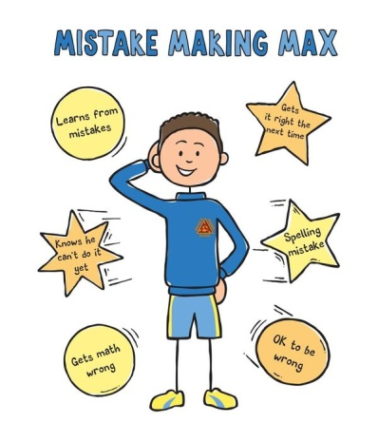
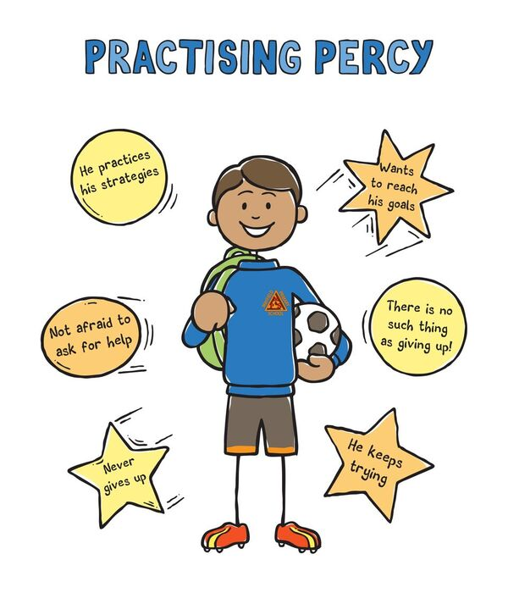
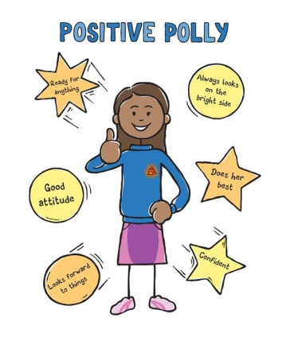
Meet Our Fieldies

Slide 5
We use our ‘Fieldies’ to talk about our learning and we also use them as awards at our Assemblies.
We link our ‘Fieldies’ to our school Motto and try to Be The Best ‘Fieldy’ We Can Be!

Slide 6
Primary 1 Classes
This session we will have two Primary 1
classes.
Primary 1B will be taught by Mrs. Beechman
and
Primary 1W will be taught by Mrs Wightman
and Mrs Jardin.
Mrs Dryden is our SLC Teacher.

Slide 7
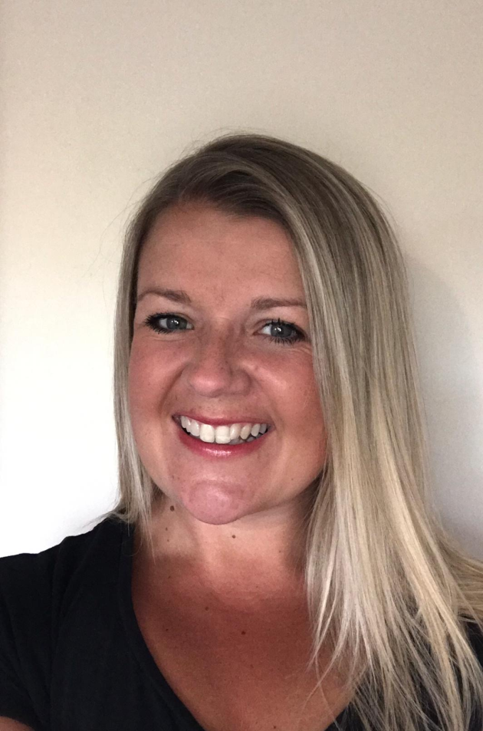
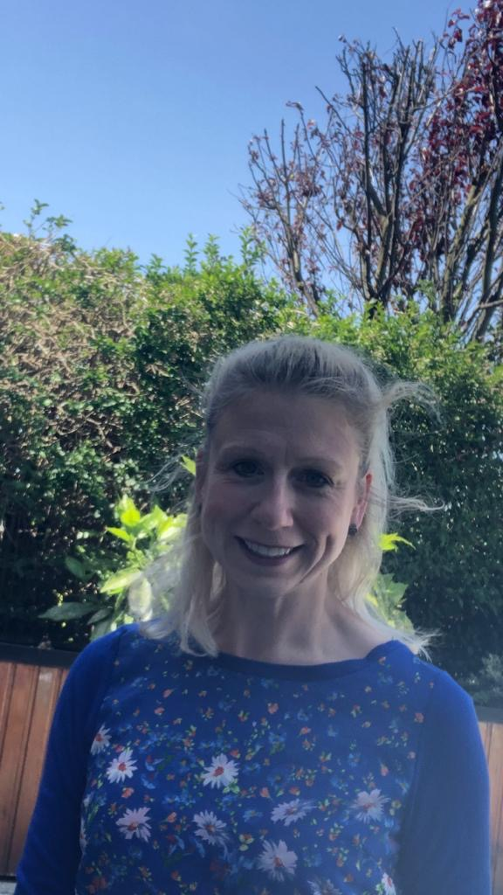
Meet our Teachers
This is Mrs Beechman, she will be teaching P1B
This is Mrs Wightman, she will be teaching P1W

Slide 8
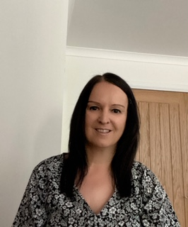
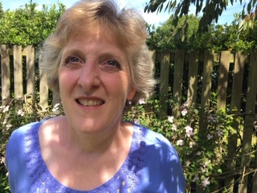
Meet our Teachers
This is Mrs Jardine, she will teach P1W on a Monday
This is Mrs Dryden – she works in the SLC

Slide 9
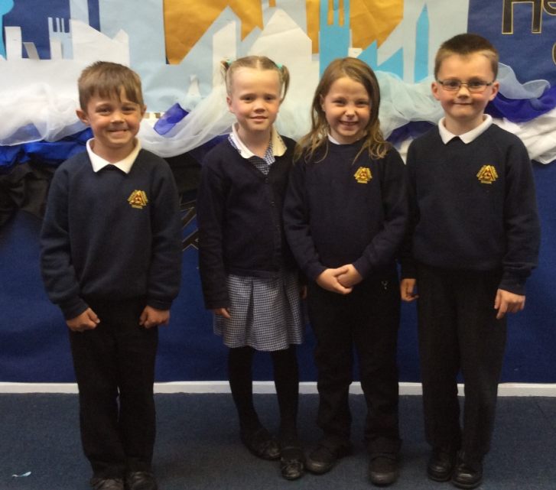
School Uniform
Navy blue sweatshirts, jumper or cardigan
White or navy polo shirts or
School shirt or blouse
Navy or black school trousers, skirt or pinafore
Navy and white checked summer dress
Order form is on our school website
ALL LABELLED!

Slide 10
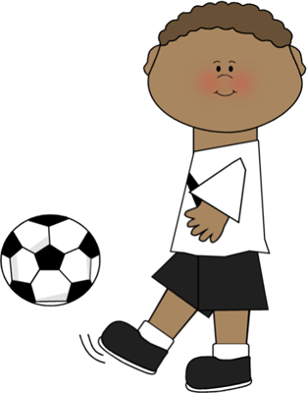
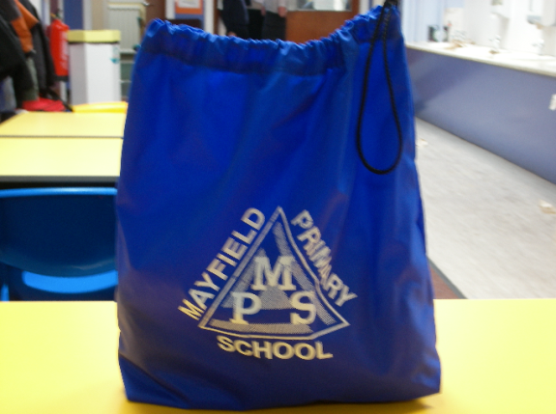
Gym Kit
Plain t-shirt
Shorts
Gym shoes
All should be name labelled, packed in a gym bag and stored in the classroom.

Slide 11
Bits and Bobs
School bags should be big enough to hold an A4 book or folder.
Each child in Primary 1 will be given a navy book bag to keep their homework jotter and any letters or correspondence home. Please check this daily and encourage your child to tell the teacher if a letter is to be returned to the school.
The school will provide pencils, colouring pencils, rubbers and sharpeners for pupils in P1.

Slide 12
School Dinners
All pupils in P1-P3 are entitled to a free school lunch daily, including a packed lunch on a Friday.
There are no hot school dinners on a Friday.
Alternatively children can bring their own packed lunch to school. We encourage healthy packed lunches. Please clearly label your child’s packed lunch bag/box.

Slide 13
Free School Meal Entitlement
All pupils in P1-P3 are entitled to a free school meal, but free school milk, clothing grant etc need to be applied for if you meet the criteria.
From P4 onwards, pupils have to pay for a school meal – if you are entitled to free school meals, it is best that you apply for this when they start school.
Please complete the form if you think you meet the criteria (see details on Mid Lothian council website.
If you would like more information, contact our school office.

Slide 14
Snacks and Milk
Milk
We have a milk time each day. Milk order forms are available in your pack. Pupils with free school meal entitlement will be given milk.
If you do not wish for your child to have milk, please provide water in a bottle that can be kept in the classroom throughout the day.

Slide 15
Snack
We encourage healthy snacks for playtime.
One snack is sufficient for morning break.
We are a nut free zone. Please do not send nuts or foods containing nuts to school.

Slide 16
Communication
We do our best to inform you of work planned for your child as well as whole school issues through our regular newsletters, school website and twitter feed. The school also uses seesaw where we share learning with our families.

Slide 17
Communication with the School
All families will have our communication chart shared at the beginning of the new term, but in summary, if you need to speak to a member of our staff:
Class Teacher
Principal Teacher
Depute Head Teacher
Head Teacher

Slide 18
Attendance and Lateness
Midlothian Council has an expectation for all pupils in primary schools to have attendance of 97% or higher
Our school monitors attendance very closely to ensure pupils wherever possible meet this expectation
Our school also monitors pupil lateness on a weekly basis
Our school has a set of procedures to monitor attendance and lateness, and parents will be contacted with regards to this
Holidays during term time are not supported by Midlothian Council and are marked as unauthorised absences
Please make sure you phone the school office, before 9:30am if your child is going to be off school ill, so that we can mark this on our registers

Slide 19
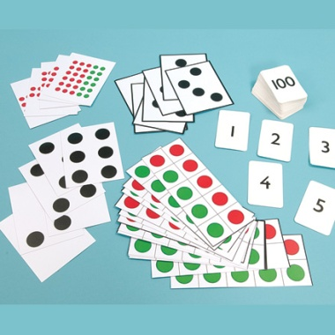
What we learn in P1
Literacy
Health & Wellbeing
Numeracy & Mathematics
French
Social Studies
Technologies & Science
Expressive Arts
Religious & Moral Education

Slide 20
We look forward to meeting all our children and families and welcoming you into our school.
We are one campus and work together with Mayfield NS and St. Luke’s PS to ensure we meet the needs of our families.

